Slide 1
Routing Algorithms for IEEE802.1Qbv Networks
15th International Workshop on Real-Time Networks
Naresh Nayak
Frank Dürr, Kurt Rothermel
27.06.2016

Slide 2
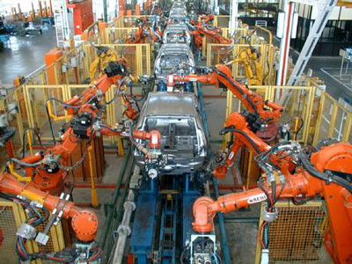






Communication in Networked Control Systems (NCS)
Networked Control Systems
Sensors, Actuators & NCS-Controller
Communication network
Actuator
Application Domains
Industrial automation
Automotive etc.
Sensor
Real-time communication requirements
Upper bounds on latencies and jitter
Motion controlled systems
  Latency < 65µs, Jitter < 1µs
Network
Real-time
Network
NCS
Controller

Slide 3
Transition to IEEE 802.3 (Ethernet) Networks
Emergence of many field-bus systems
Incompatibilities between field-buses
Loss of real-time guarantees when interoperated
Dedicated solution, expensive
Transition to IEEE 802.3 (Ethernet) n/w
High performance, low cost
Ubiquitous
➔ But designed only for best effort service
Initiatives for real-time capabilities for Ethernet
IEEE – Time-sensitive Networking Task Group
  IEEE 802.1AS – Clock Synchronization
  IEEE 802.1Qat – Stream Reservation Protocol
  IEEE 802.1Qbu – Frame Pre-emption
  IEEE 802.1Qbv – Enhancements for scheduled traffic
  among others
IETF – DetNets Working Group
  Real-time properties over WAN

Slide 4
IEEE 802.1Qbv – Enhancements for scheduled traffic
Switch port
Gate
Traffic class 0
Gate
Queues for best-effort (BE) traffic
Reserved queue(s) for scheduled traffic and best-effort traffic
Best-effort Traffic
Scheduled Traffic
Traffic class 5
Gate
Gate
Output selector
Gate
Traffic class 6
Gate
Queue for scheduled traffic (ST)
Traffic class 7
Gate
Gate
Gate Driver
t1 close BE Gates
t2 open ST Gate
... …
t_{n} …
repeat
How to handle scheduled traffic using this mechanism?
Time-based gating program

Slide 5
Routing & Scheduling Problem in IEEE 802.1Qbv networks
Isolate time-triggered flows to bound
queuing delays
  Spatial domain (Routing)
  Temporal domain (Scheduling)
Flows routed using off-the-shelf
routing algorithms
Subsequently scheduling over
every link traversed by the flow
Link Transmission Schedule
Dst for F₁
Src for F₁
Src for F₂
Dst for F₁
Hosts
Dst for F₂
Switches

Slide 6
State-Of-The-Art Scheduling Approaches
Approaches based on Satisfiability Modulo Theories
  Steiner RTSS-2010, Craciunas et al. RTNS-2016
  Model TSN scheduling problem using satisfiability constraints
  Computes one feasible schedule
Mapping TSN Scheduling Problem to other known scheduling problems
  No-wait Job-shop Scheduling Problem – Dürr et al. [RTNS-2016]
  Resource Constrained Scheduling Problem – Hanzalek et al. [IEEE TII. 2010]
  Optimizes schedule length (Makespan)
Relation between routing algorithms & scheduling algorithms not yet studied with respect to IEEE 802.1Qbv

Slide 7
Contributions in this paper
Explore the impact of routing time-triggered flows on their schedulability
  Scope restricted to scheduling using the No-wait Job-shop Scheduling Problem
Identify metric(s) for routing algorithms that consider also the schedulability and propose tailored routing algorithms for IEEE802.1Qbv network
  Algorithm 1: Maximum Scheduled Traffic Load (MSTL) Based Routing
  Algorithm 2: Maximum Scheduled Traffic Load (MSTL) + Hops Based Routing
Evaluations show 30-60% improvement in schedulability of time-triggered flows using proposed algorithms compared to benchmark algorithms

Slide 8
System Model
Network Controller
Solves scheduling/routing problem
Add/remove
time-triggered
real-time flows
(src, dst, cycle time,
packet size)
Global view onto
network & real-time flows
Schedule and route config.
Explicit forwarding path control
(IEEE 802.1Qca or OpenFlow)
Real-time traffic scheduling
through time-triggered gates
(IEEE 802.1Qbv)
IEEE 802.1AS for precise
clock synchronization

Slide 9
No-wait Job-shop Scheduling Problem in Operations Research
Well-known problem in operations research – NP-hard
Scheduling set of jobs (sequence of operations) on a set of machines in shopfloor
  Compute schedules of minimal length (makespan)
Example: 2 machines (M₁, M₂) executing 3 jobs (J₁, J₂, J₃)
  Job J₁: M₁ (2 time units)
  Job J₂: M₂ (2 time units), M₁ (1 time unit)
  Job J₃: M₁ (3 time units), M₂ (1 time unit)
J₃
M₁
M₂
J₃
M₁
M₂
J₂
M₂
M₁
J₂
M₂
M₁
J₁
M₁
No-wait constraints
J₁
M₁
makespan = 6
makespan = 7

Slide 10
NW-JSSP in IEEE 802.1Qbv Networks
Host network interfaces & switch ports → Machines (performing forwarding operations)
Time-triggered flows → Jobs
  Seq. of forwarding operations by switch ports & network interfaces = Routes of the flows
  Time for each operation = Serialization time for the pkts of the flow on the corresponding link
Flowspan
Slack
Dst A
Src A
l₃
l₄
l₇
Flow C
l₁
l₅
l₂
l₄
l₆
Flow B
l₂
l₄
l₆
l₁
l₄
l₅
Flow A
Src B
Dst B
l₃
l₇
T_{Cycle}
Src C
Dst C
Refer Dürr et al. RTNS-2016 for more details

Slide 11
Problem Statement – Routing of Time-triggered Flows
Number of hops used as the metric
  Shortest path routing, Equal-cost Multi Pathing etc.
  Agnostic to the underlying scheduling problem
  of time-triggered flows
  Leads to bottleneck links → Infeasible schedules
  i.e. Flowspan > T_{Cycle}
Goal: Reduce bottlenecks & improve schedulability
  Minimize flowspan & improve schedule slack
  Maximum Scheduled Traffic Load (MSTL) as metric
    Maximum amount of scheduled traffic sent out
    over any of the port per scheduling cycle
100
75
50
75+50=125
MSTL = 125 bytes

Slide 12
Problem Statement – Routing of Time-triggered Flows
Number of hops used as the metric
  Shortest path routing, Equal-cost Multi Pathing etc.
  Agnostic to the underlying scheduling problem
  of time-triggered flows
  Leads to bottleneck links → Infeasible schedules
  i.e. Flowspan > T_{Cycle}
Goal: Reduce bottlenecks & improve schedulability
  Minimize flowspan & improve schedule slack
  Maximum Scheduled Traffic Load (MSTL) as metric
    Maximum amount of scheduled traffic sent out
    over any of the port per scheduling cycle
100
100+75
75
50
MSTL = 175 bytes

Slide 13
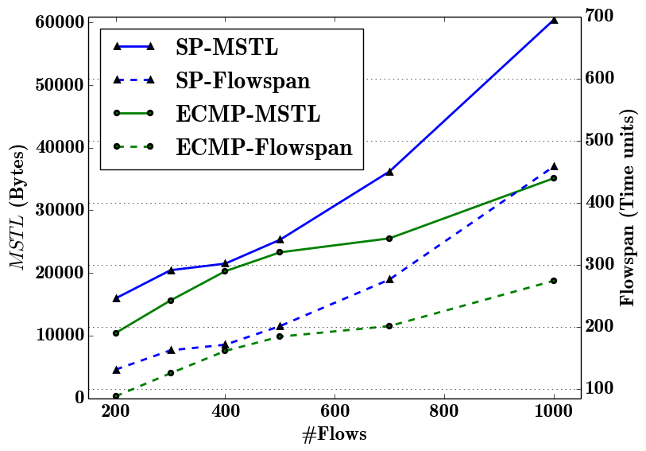
Relation between Flowspan & MSTL
Evaluation Scenario
Erdős-Rényi Topology
  10 Switches
  50 Hosts
Time-triggered flows
  Hosts and destination is selected
  with uniform distribution
  Size of flow uniformly distributed
  between 300-1500 Bytes
Flowspan increases with an increase in the MSTL

Slide 14
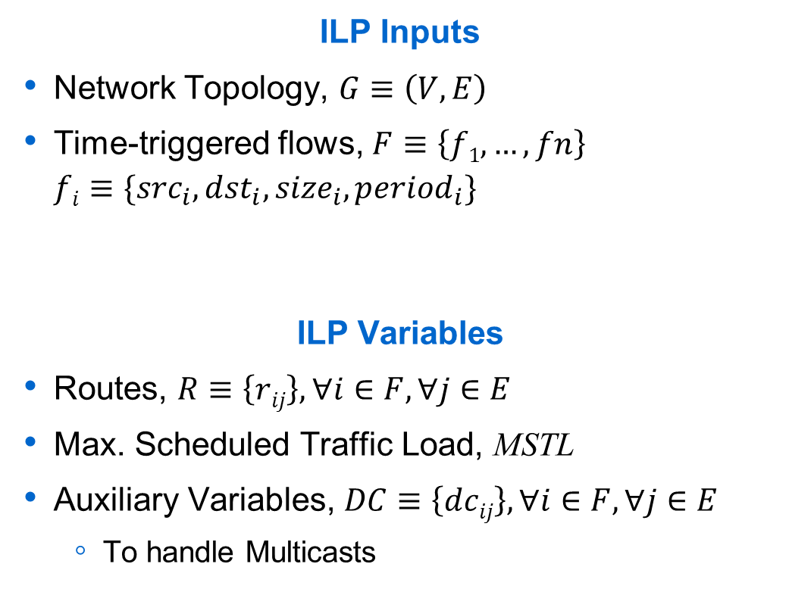
Algorithm 1: MSTL-Based Routing – Terminologies & Objective
ILP Inputs
Network Topology, $G≡\left(V,E\right)$
Time-triggered flows, $F≡\left\{f1, …, fn\right\}$
$fi≡\{{src}_{i}, {dst}_{i}, {size}_{i}, {period}_{i}\}$
ILP Variables
Routes, $R≡\left\{rij\right\}, ∀i∈F, ∀j∈E$
Max. Scheduled Traffic Load, MSTL
Auxiliary Variables, $DC≡\left\{dcij\right\}, ∀i∈F, ∀j∈E$
  To handle Multicasts
ILP Objective
Minimize: MSTL

Slide 15

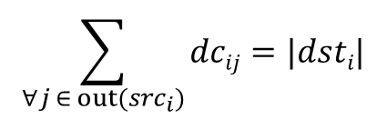
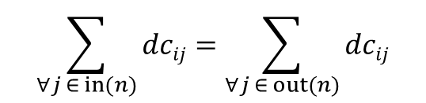


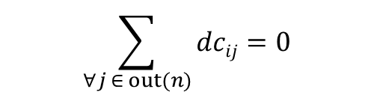


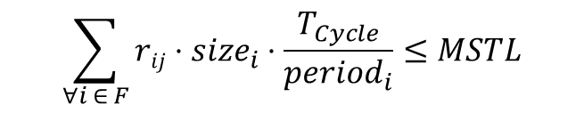
MSTL-Based Routing – Constraints
Routing Constraints (For all flows i)
Load Constraints (For all links j)
$$\sum_{∀j ∈ in({src}_{i})}{dcij}=0$$
$$\sum_{∀j ∈ out({src}_{i})}{dcij}=|dsti|$$
$$\sum_{∀j ∈ in(n)}{dcij}=1$$
$$\sum_{∀j ∈ out(n)}{dcij}=0$$
$$∀ n∈{dst}_{i}$$
$$\sum_{∀j ∈ in(n)}{dcij}=\sum_{∀j ∈ out(n)}{dcij}$$
$$∀ n∈V∖(\left\{{src}_{i}\right\}∪{dst}_{i})$$
Auxiliary Constraints (For all flows i & links j)
$$\sum_{∀i ∈ F}{rij}⋅{size}_{i}⋅\frac{T_{Cycle}}{{period}_{i}}≤MSTL$$
$$r_{ij}⋅\left|{dst}_{i}\right|≥ {dc}_{ij}$$

Slide 16
Algorithm 2: MSTL-Based + Hops based Routing
MSTL-based routing considers only the scheduled traffic
May route flows over longer paths
  Acceptable, if it indeed reduces the MSTL
  Undesirable, if it has no impact on MSTL
Extend MSTL-based routing to also incorporate length of allocated route
  Modified objective
$$\frac{MSTL}{1+ \sum_{F}{{size}_{i}}}+ \frac{\sum_{F}{\sum_{E}{r_{ij}}}}{1+ (\left|F\right|⋅|E|)}$$
Minimize

Slide 17
Evaluation Setup
Commodity hardware for network controller
  Intel Xeon E5-1650 (2 x 6 processor cores)
  16GB RAM
Evaluation over randomized graph models & randomized traffic patterns
  Erdős-Rényi Model & Barabási-Albert Model
    50-100 hosts and 10-20 switches
  Varying number of flows (200-1000)
    Source and destinations chosen using uniform distribution

Slide 18
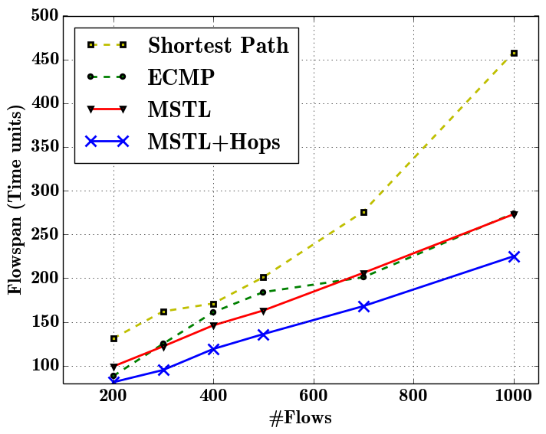
Evaluations
Evaluation Scenario
Erdős-Rényi Topology
  10 switches & 50 hosts
Routing using benchmark algorithms and proposed algorithms
Subsequent schedule computation using No-wait Job-shop Scheduling
Flowspan reduction of MSTL+Hops: Max. 60% (Avg. 38%) against SP
Max. 30% (Avg. 20%) against ECMP

Slide 19
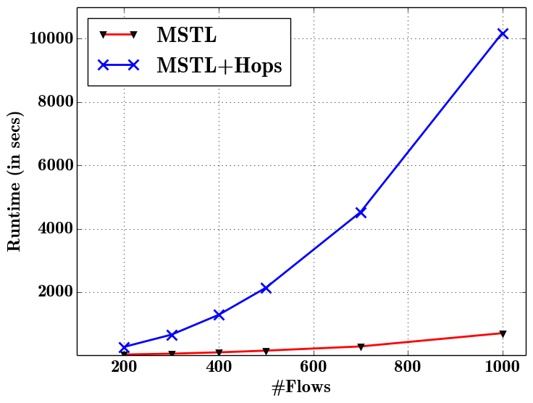
Evaluations
Evaluation Scenario
Erdős-Rényi Topology
  10 switches & 50 hosts
Varying number of flows (200-1000)
Runtime evaluations: MSTL-based algorithm scales linearly compared to the exponential increase in the MSTL+Hops based algorithm

Slide 20
Related Work
IEEE 802.1Q & IEEE 802.1qa
  Rapid-spanning tree protocol
  Multiple-spanning tree protocol
  Shortest-path bridging
Laursen et al. – Routing Optimization of AVB Streams in TSN Networks [RTN-2016]
  Routing optimization of AVB Streams to meet the timing constraints
Nayak et al. – TSSDN [RTNS-2016]
  Combined solution of routing & scheduling problem
  Coarse grained schedules instead of link-based schedules

Slide 21
Conclusion & Future Work
Conclusion
Explored the relation between routes of time-triggered flows and their schedulability
Motivated the need for metrics (in addition to number of hops) to incorporate awareness to scheduled traffic in the routing algorithms
Presented two ILP-based routing algorithms yielding up to 30-60% improvement in the schedulability compared to standard routing algorithms
Future Work
Develop heuristics for improving runtimes of the routing algorithms
Extend the algorithms to handle routing of dynamic flows
Generalize the algorithms to be applicable for other scheduling approaches as well

