Slide 1
Constraint-Aware Software-Defined Network for Routing
Real-Time Multimedia
Name: Oluwaseyi Oginni
Faculty of Computing, Engineering and The Built Environment. Birmingham City University.

Slide 2
Introduction
Software-defined network for professional real-time Audio and Video transmission over TCP/IP networks
Dynamic Quality of Service (QoS) Routing to improve traffic management capabilities through adaptive path provisioning.
Real-time Monitoring

Slide 3
Requirements
According to Internet Engineering Task Force (IETF), some of the essential requirement for ProAV include:
Layer 3 routing
Content transmission with bounded latency
Single Network for A/V and IT traffic
Standards-based, interoperable, multi-vendor
Easy to deploy
Scalability
Notes:
It would be valuable to enable IP to connect multiple Layer 2 LANs.
As an example, ESPN recently constructed a state-of-the-art 194,000 sq ft, $125 million broadcast studio called DC2. The DC2 network is capable of handling 46 Tbps of throughput with 60,000 simultaneous signals. Inside the facility are 1,100 miles of fiber feeding four audio control rooms (see [ESPN_DC2] ).
In designing DC2 they replaced as much point-to-point technology as they could with packet-based technology. They constructed seven individual studios using layer 2 LANS (using IEEE 802.1 AVB) that were entirely effective at routing audio within the LANs. However to interconnect these layer 2 LAN islands together they ended up using dedicated paths in a custom SDN (Software Defined Networking) router because there is no standards-based routing solution available.
And, also thanks to DC-2, ESPN's set to broadcast shows filmed there in 1080p instead of 720p

Slide 4
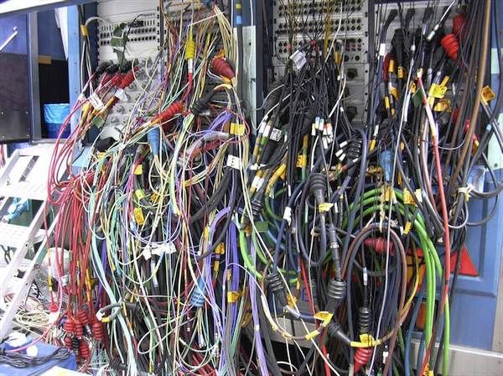
Classic Audio and Video Distribution
They only support single channel per cable
They are unidirectional
They use a point-to-point link architecture
Wiring of a patch bay of an outside broadcasting van

Slide 5
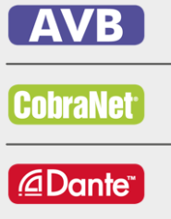
Existing Network media Solutions
Cobranet, Audio Video Bridging(AVB), Dante etc
No interoperability
It is not possible to add your own features
Complex to deploy
No Layer 3 routing support
Notes:
Because of the inadequacies of existing multimedia networked solutions, The TSN has been created to …

Slide 6
Traffic Engineering and QoS Routing
Very complex to implement
High Cost
Notes:
Around 2015 there was a general consensors for using centralised control The general consensus in the IEEE TSN working groups is that a centralized approach to creating the schedule for TSN elements is better than the hop-by-hop approach reflected in AVB.

Slide 7
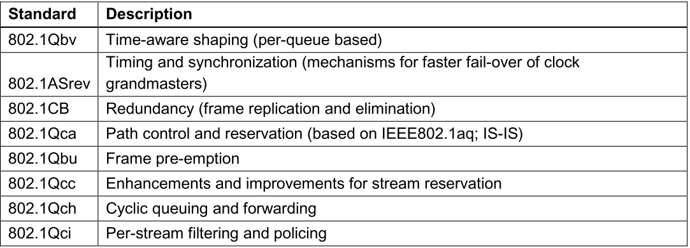
TSN (Time-Sensitive Networking)
Emerging Standard formally Audio Video Bridging (AVB)
TSN achieves deterministic real-time communication over Ethernet by using global time and a schedule which is created for message paths across multiple network components.

Slide 8
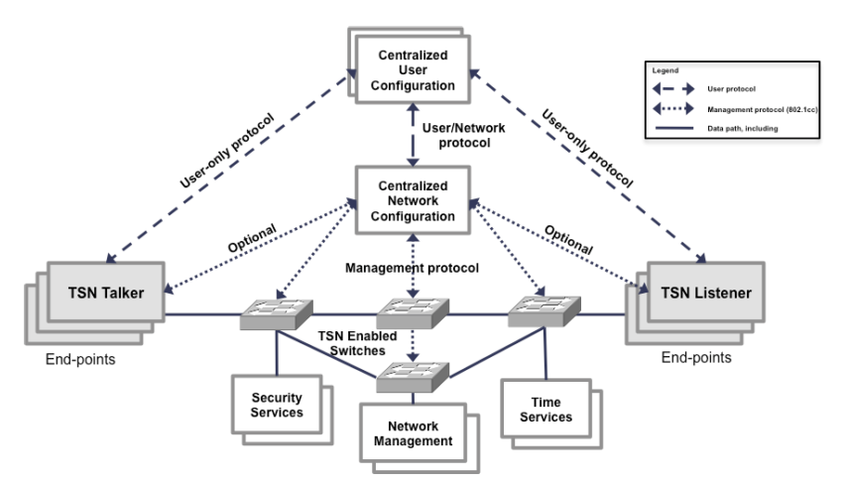
TSN
Centralized vs. Decentralized Control
The general consensus in the IEEE TSN working groups is that a centralized approach to creating the schedule for TSN elements is better than the hop-by-hop approach reflected in AVB.
TSN System [1]
[1] G. A. Ditzel and P. Didier, “Time Sensitive Network ( TSN ) Protocols and use in EtherNet / IP Systems Table of Contents,” in 2015 ODVA Industry Conference & 17th Annual Meeting, 2015, pp. 1–24.

Slide 9
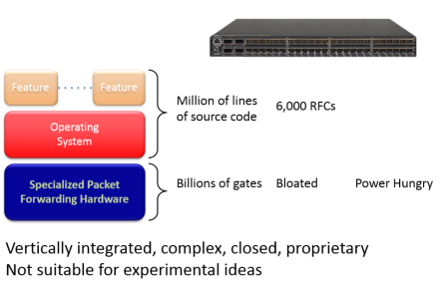
Limitations of Traditional Networks
Features
Million of lines of source code
Operating
System
Specialized Packet Forwarding Hardware
Notes:
Difficult to perform real world experiments on large scale production networks.
Research stagnation-huge costly equipment to be procured and networks to be setup by each team for research
Networks have remained the same for many years
Rate of innovation in networks is slower as protocols are defined in isolation-lack of high level abstraction.
Closed systems
Hard to collaborate meaningfully due to lack of standard open interfaces.
Vendors starting to open-up but not meaningfully.
Innovation is limited to vendor/vendor partners
Huge barriers for new ideas in networking.

Slide 10
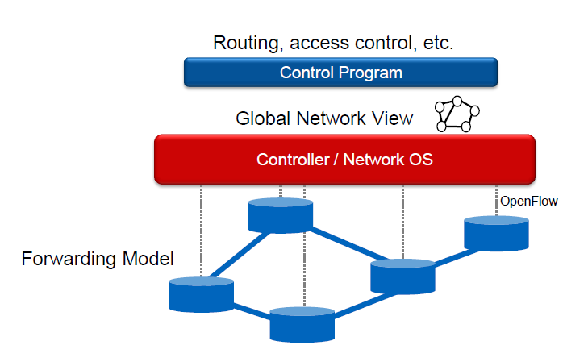
Software-Defined Networking (SDN)
An architecture in networking where control and data planes are decoupled and intelligence and state is logically centralized
Software-Defined Network Architecture

Slide 11
Current Internet
Software-defined Network
Closed to Innovations in the Infrastructure
APP
APP
APP
Operating System
APP
APP
Close
Closed
APP
Operating System
Open Interface
APP
APP
APP
APP
APP
Operating System
Specialised Packet Forwarding Hardware
APP
Operating System
APP
Specialised Packet Forwarding Hardware
Operating System
Specialised Packet Forwarding Hardware
Specialised Packet Forwarding Hardware
Notes:
The diagram shows difference between current network

Slide 12
Why SDN
Facilitate innovation in network.
Layered architecture with standard Open interfaces.
Experiment and research using non-bulky, non-expensive equipment.
More flexibility with programmability.
Ease of customization and integration with other software applications

Slide 13
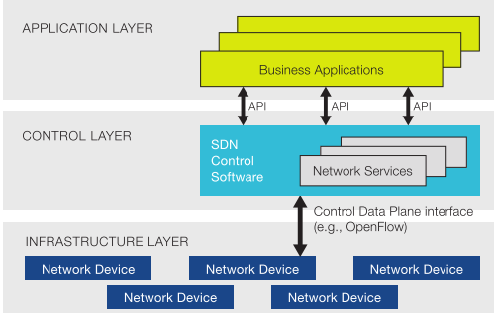
SDN Layers
Infrastructure layer: consists of both physical and virtual network devices such as switches and routers..
Control layer: This layer consists of a centralized control plane. It provides centralized global view to entire network.
Application layer: it consists of network services, application and orchestration tools that are used to interact with control layer.
Notes:
Data Plane: processing and delivery of packets
Based on state in routers and endpoints
E.g., IP, TCP, Ethernet, etc.
Control Plane: establishing the state in routers
Determines how and where packets are forwarded
Routing, traffic engineering, firewall state, …
Separate control plane and data plane entities
Have programmable data planes—maintain, control and program data plane from a central entity i.e. control plane software called controller.
An architecture to control not just a networking device but an entire network.

Slide 14
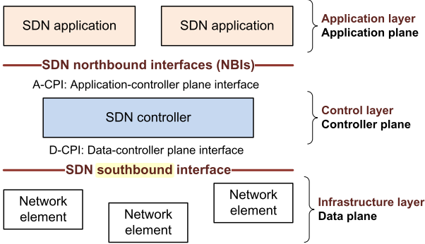
SDN Interfaces
The infrastructure layer comprises network elements, which expose their capabilities toward the control layer (controller plane) via interfaces southbound from the controller.
The SDN applications exist in the application layer (plane), and communicate their network requirements toward the controller plane via northbound interfaces, often called NBIs
Notes:
The aim of SDN is to provide open interfaces that enable the development of software that can control the connectivity provided by a set of network resources and the flow of network traffic though them, along with possible inspection and modification of traffic that may be performed in the network. These primitive functions may be abstracted into arbitrary network services, some of which may not be presently apparent.
The infrastructure layer (data plane, note) comprises network elements, which expose their capabilities toward the control layer (controller plane) via interfaces southbound from the controller. The SDN applications exist in the application layer (plane), and communicate their network requirements toward the controller plane via northbound interfaces, often called NBIs. In the middle, the SDN controller translates the applications’ requirements and exerts low-level control over the network elements, while providing relevant information up to the SDN applications. An SDN controller may orchestrate competing application demands for limited network resources according to policy.
from ryu.base import app_manager
from ryu.topology import event
from ryu.topology.api import get_switch, get_link
from ryu.controller import ofp_event
from ryu.controller.handler import MAIN_DISPATCHER, DEAD_DISPATCHER
from ryu.controller.handler import CONFIG_DISPATCHER
from ryu.controller.handler import set_ev_cls
from ryu.ofproto import ofproto_v1_3
class switchlist(app_manager.RyuApp):
OFP_VERSIONS = [ofproto_v1_3.OFP_VERSION]
def __init__(self, *args, **kwargs):
super(switchlist, self).__init__(*args, **kwargs)
self.topology_api_app = self
events = [event.EventSwitchEnter,
event.EventSwitchLeave, event.EventPortAdd,
event.EventPortDelete, event.EventPortModify,
event.EventLinkAdd, event.EventLinkDelete]
@set_ev_cls(events)
def get_topology(self, ev):
myswitches = []
switch_list = get_switch(self.topology_api_app, None)
for list in switch_list:
myswitches.append(list.dp.id)
print myswitches
ryu-manager --observe-links ryu/app/gui_topology/gui_topology.py
http://192.168.159.131:8080/stats/switches
http://192.168.159.131:8080/stats/flow/1

Slide 15
OpenFlow Protocol
OPENFLOW is an open API that provides a standard interface for programming the data plane switches.
An OpenFlow switch has one or more tables consisting of flow rules. Each rule matches a subset of the traffic and performs certain actions (dropping, for- warding, modifying, etc.) on the traffic

Slide 16
SDN Controller
Ryu is a component-based software defined networking framework.
Ryu provides software components with well defined API that make it easy for developers to create new network management and control applications.

Slide 17
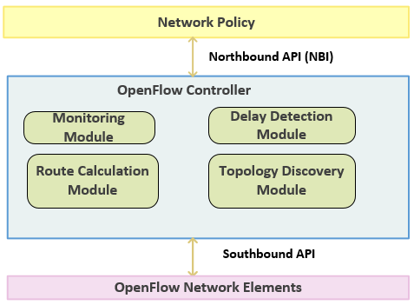
Constraint-Aware Controller
Provides custom routing based on Available bandwidth, latency and shortest path.
Collects topology information and network statistics by monitoring network in real-time

Slide 18
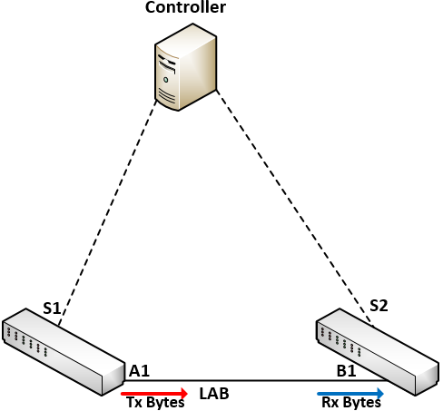
Network Monitoring Module
In order to calculate the available bandwidth, the controller sends OFPPortStatsRequest message to request for port-related statistical information from switches.
Number of transmitted byte on Port A₁ | Tx
Number of transmitted byte on Port B₁ | Rx
Total Port Bandwidth of A1 | A_{1total}
Total Port Bandwidth of B1 | B_{1total}
Used bandwidth on port A1 over period T (U_{A1}) | $$\frac{ΔTx}{T}$$
Used bandwidth on port B1 over period T (U_{A2}) | $$\frac{ΔRx}{T}$$
Available Bandwidth on port A1 (BW_{A1}) | A_{1total} – U_{A1}
Available Bandwidth on port B1 (BW_{B1}) | B_{1total} – U_{A1}
Available bandwidth on link L_{AB} | Min(BW_{A1}, BW_{B1})

Slide 19
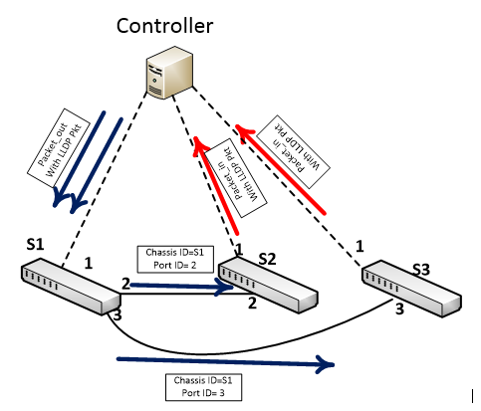
Topology discovery
Topology discovery in achieved in SDN through Link Layer Discovery Protocol.
This mechanism, referred to as OFDP (OpenFlow Discovery Protocol)

Slide 20
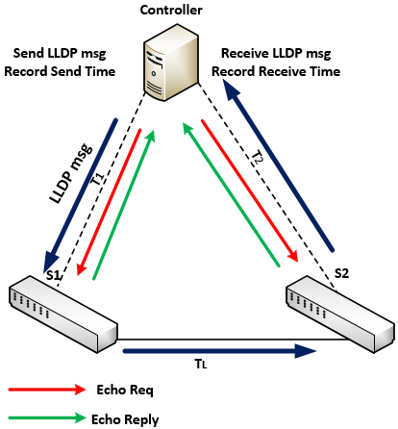
Delay Detection Module
The network delay detection module utilizes Ryu controller’s LLDP API to obtain the timestamp of LLDP packets being transmitted.
Delay between controller and switch is (echo receive time-echo send time)/2.
Total Delay is LLDP Receive time - Send time
T_{L} = T_{total} – T₁-T_{2.}
Notes:
The controller sends an LLDP packet to S1 with a send timestamp. S1 sends to S2 and S2 to the controller. controller then calculates the total delay (Ttotal) from the controller back to the controller by subtracting the send time from the receive time of the LLDP packet. In order to get the between controller and switch, the controller sends an OFPEchoRequest with data being send time. The switch replies with OFPEchoReply message with the same data.

Slide 21
Routing Module
The Routing module selects best path based on the appropriate constraint using the Djikstra Shortest Path algorithm.
Example
g = nx.Graph()
g.add_edge(’a’,’b’,weight=0.1)
g.add_edge(’b’,’c’,weight=1.5)
g.add_edge(’a’,’c’,weight=1.0)
g.add_edge(’c’,’d’,weight=2.2)
D
2.2
1.5
C
B
1.0
print nx.shortest_path(g,’b’,’d’)
[’b’, ’c’, ’d’]
A
0.1
print nx.shortest_path(g,’b’,’d’,weighted=True)
[’b’, ’a’, ’c’, ’d’]
Notes:
There may be delay due to processing time and the overhead on the controller due to real time monitoring.
The overhead on the switches will be lower than that of a normal switch.
For instance the cisco switches that support AVB are the high end switches they cost 10s of thousands of dollars.
You can use existing libraries such as network X
An example Implementation of shortest path algorithm can be found in. https://networkx.github.io/documentation/networkx-1.10/tutorial/tutorial.html

Slide 22
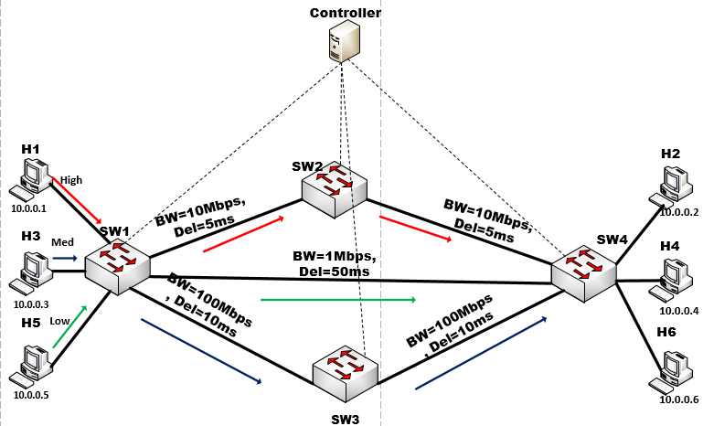
Testing and Results
Test Network was created using Mininet Network Emulator

Slide 23
Summary
SDN is a new network paradigm that can change the way we design our networks in the future. It simplifies the network by separating control and data plane and centralises the control plane.
SDN Constraint-aware routing can help increase overall network performance through efficient network resource utilization.
Already existing distributed media solutions such as AVB can also leverage the centralised control obtained in an SDN network, while maintaining the ability to support real-time synchronous data using distributed network protocols.

Slide 24
FUTUREWORK
Implement QoS module that will provide admission control and traffic shaping functions
Experimental testing will also be expanded to include tests for other network parameters such as jitter, delay and bandwidth utilisation.
Experiments will also be executed with hardware

Slide 25
Questions

Slide 26
Reference
Open Networking Foundation, “Software-Defined Networking: The New Norm for Networks,” ONF White Paper, 2012. [Online]. Available: https://www.opennetworking.org/images/stories/downloads/sdn-resources/white-papers/wp-sdn-newnorm.pdf. [Accessed: 21-Jul-2015]
M. J. Teener, A. Huotari, Y. Kim, R. Kreifeldt, and K. Stanton, “No-excuses Audio Video Networking : the Technology Behind AVnu,” 2009.

