Slide 1

Verifying Weakly-Hard Real-Time Properties of Traffic Streams in Switched Networks
Leonie Ahrendts, Sophie Quinton, Thomas Boroske, Rolf Ernst
TU Braunschweig
ECRTS in Barcelona, July 5th 2018

Slide 2



Introduction
Modern embedded systems are often distributed.
Processing elements (PE) are connected through data buses or switched networks.
PEs send traffic streams to remote PEs.
PE
PE
PE
Traffic streams are subject to real-time (RT) requirements:
hard = no deadline misses
weakly-hard = at most m deadline misses in k transmissions
formal RT guarantees
formal RT guarantees
high cost
intermediate cost
but functional robustness required
e.g. image processing
control algorithms

Slide 3
Related Work
Can we compute WHRT guarantees for RT networks?
No.
What can we compute?
maximum end-to-end latency
CPA
  event stream propagation
Network Calculus
  propagation of workload & remaining service
PE
PE
local WHRT guarantees
TWCA
  general system model
  compatible with CPA
Individual works
  restricted system model
  high accuracy
PE
Idea: Combine CPA + TWCA to compute end-to-end WHRT guarantees.

Slide 4



How to combine CPA & TWCA?
Traffic stream = distributed event-triggered task chain on SPNP-scheduled components
$$τ_{1}$$
$$τ_{2}$$
$$τ_{3}$$
component-related analysis
computation of output event streams
TWCA
computes WHRT guarantees for tasks
CPA
computes output event streams
compatible with different component-related timing analysis techniques
Major open issue:
TWCA expects an event stream to be decomposed into streams of typical and overload events! CPA is agnostic of these event types!

Slide 5












CPA – Interface
CPA computes based on local analysis results:
input event stream
bounded by
output event stream
bounded by
$$η_{i}^{−}\left(Δt\right), η_{i}^{+}\left(Δt\right)$$
$$η_{i+1}^{−}\left(Δt\right), η_{i+1}^{+}\left(Δt\right)$$
$$τ_{i}$$
$$τ_{i+1}$$
$$n$$
$$η_{i}^{+}\left(Δt\right)$$
$$n$$
$$η_{i+1}^{+}\left(Δt\right)$$
$$η_{i}^{−}\left(Δt\right)$$
$$η_{i+1}^{−}\left(Δt\right)$$
$$Δt$$
$$Δt$$

Slide 6

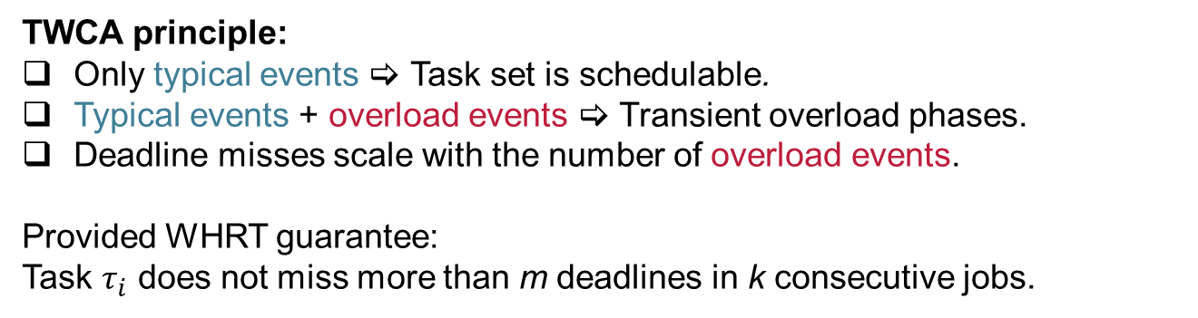
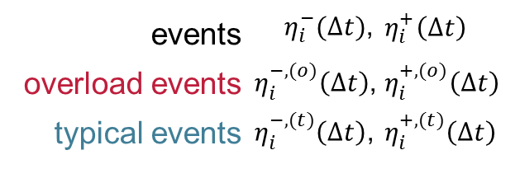
TWCA – Interface
missing event stream propagation !
lower and upper bounds for:
events | ${ η}_{i}^{−}(Δt)$, | $$η_{i}^{+}\left(Δt\right)$$
overload events | $η_{i}^{−,(o)}\left(Δt\right)$, | $$η_{i}^{+,(o)}\left(Δt\right)$$
typical events | $η_{i}^{−,(t)}\left(Δt\right)$, | $$η_{i}^{+,(t)}\left(Δt\right)$$
?
$$τ_{i}$$
?
?
TWCA principle:
Only typical events  Task set is schedulable.
Typical events + overload events  Transient overload phases.
Deadline misses scale with the number of overload events.
Provided WHRT guarantee:
Task $τ_{i}$ does not miss more than m deadlines in k consecutive jobs.

Slide 7

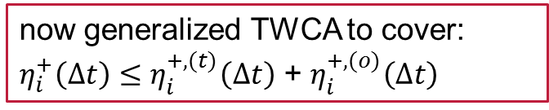



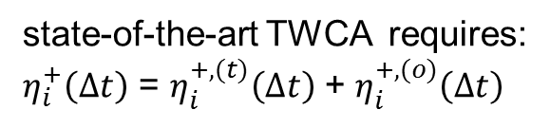

TWCA – Interface
Relation between $η_{i}^{+}\left(Δt\right),$ $η_{i}^{+,(t)}\left(Δt\right)$ and $η_{i}^{+,(o)}\left(Δt\right)$
state-of-the-art TWCA requires:
$η_{i}^{+}\left(Δt\right)$ = $η_{i}^{+,(t)}\left(Δt\right)$ + $η_{i}^{+,(o)}\left(Δt\right)$
now generalized TWCA to cover:
$η_{i}^{+}\left(Δt\right)≤$ $η_{i}^{+,(t)}\left(Δt\right)$ + $η_{i}^{+,(o)}\left(Δt\right)$
$$n$$
$$n$$
$$η_{i}^{+}\left(Δt\right)$$
$$η_{i}^{+}\left(Δt\right)$$
$$η_{i}^{+,(t)}\left(Δt\right)$$
$$η_{i}^{+,(t)}\left(Δt\right)$$
$$η_{i}^{+,(o)}\left(Δt\right)$$
$$η_{i}^{+,(o)}\left(Δt\right)$$
$$Δt$$
$$Δt$$
e.g. minimum distance between any two events!

Slide 8
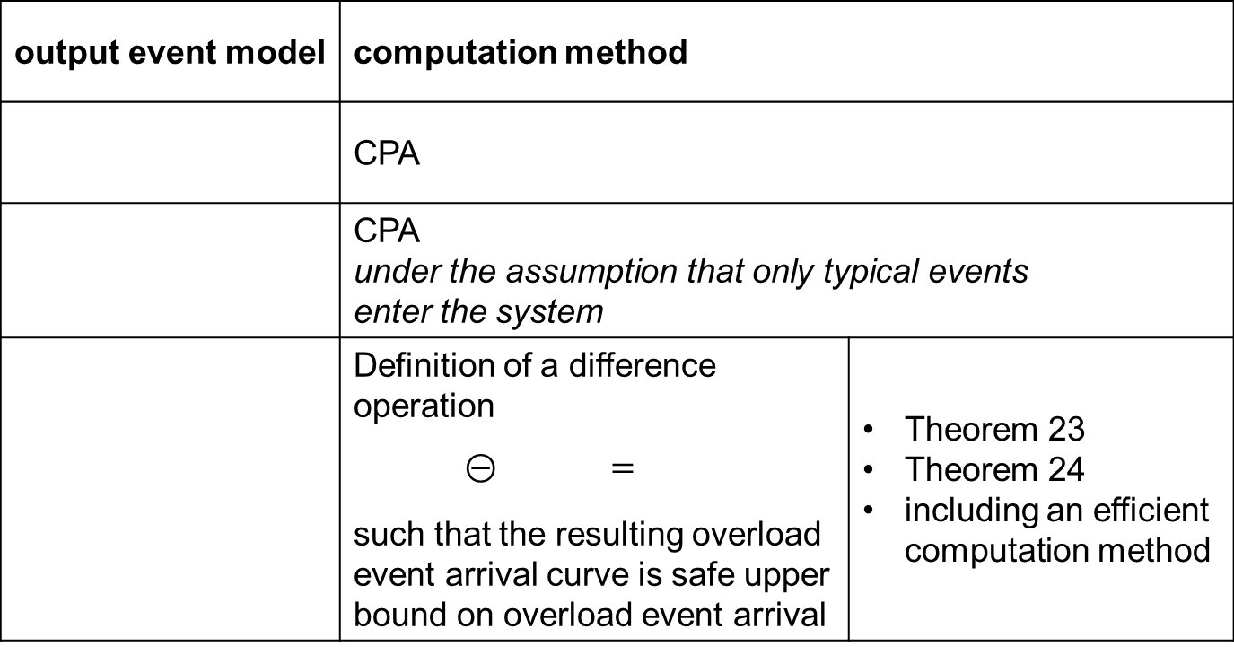
TypicalCPA – Output event stream computation
output event model | computation method
 | CPA
 | CPA under the assumption that only typical events enter the system
 | Definition of a difference operation $⊝$ $=$ such that the resulting overload event arrival curve is safe upper bound on overload event arrival | Theorem 23 Theorem 24 including an efficient computation method
?
?
?
Notes:
backup Folie hinzufügen

Slide 9




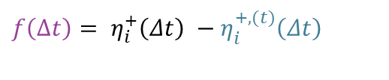
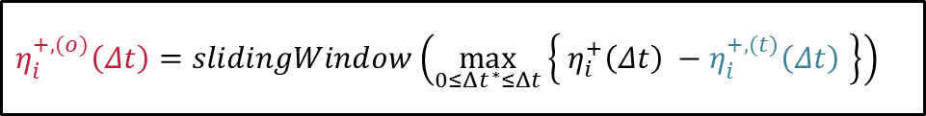

TypicalCPA – Difference operation
$$n$$
$$η_{i}^{+}\left(Δt\right)$$
$$η_{i}^{+,(t)}\left(Δt\right)$$
$$η_{i}^{+,(o)}\left(Δt\right)=slidingWindow(\tilde{f}\left(Δt\right))$$
$$\tilde{f}\left(Δt\right)=\max_{0≤Δt^{∗}≤Δt}\left\{{ η}_{i}^{+}\left(Δt\right) −η_{i}^{+,(t)}\left(Δt\right) \right\}$$
$${f\left(Δt\right)= η}_{i}^{+}\left(Δt\right) −η_{i}^{+,(t)}\left(Δt\right)$$
$$Δt$$
$$η_{i}^{+,(o)}\left(Δt\right)=slidingWindow\left(\max_{0≤Δt^{∗}≤Δt}\left\{{ η}_{i}^{+}\left(Δt\right) −η_{i}^{+,(t)}\left(Δt\right) \right\}\right)$$

Slide 10
Overview
TypicalCPA
CPA
Derive inital input event models
TWCA
Difference operation
Update output event models
Difference operation
Perform local SPNP analysis
Convergence of event models?
no
yes
Output: event models
CPA
Derive inital typical input event models
Difference operation
Difference operation
Udpate output event models
Difference operation
Perform local SPNP analysis
Convergence of event models?
no
yes
Output: typical event models

Slide 11





Evaluation
Automotive backbone network
case study with (anonymized) data from Daimler [Thiele et al. 2014]
    Switched Ethernet
    different topologies
    periodic traffic streams:
    50 control streams + 4 camera streams
addition of sporadic control traffic
    camera streams are robust towards a limited number of deadline misses
    configurable number of sporadic control streams
random generation of incomplete data:
path generation
payload sizes, periods
$$n$$
$$T_{out}$$
sporadically bursty event arrival
$$T_{in}$$
here: $b=3$
$$Δt$$
Notes:
b=3 special case (discard possibly)

Slide 12
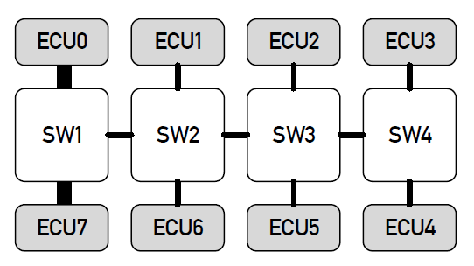
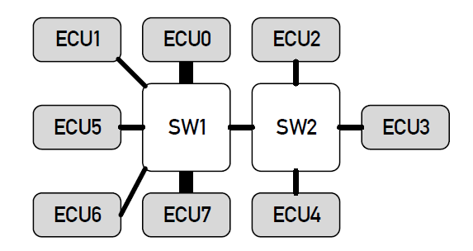
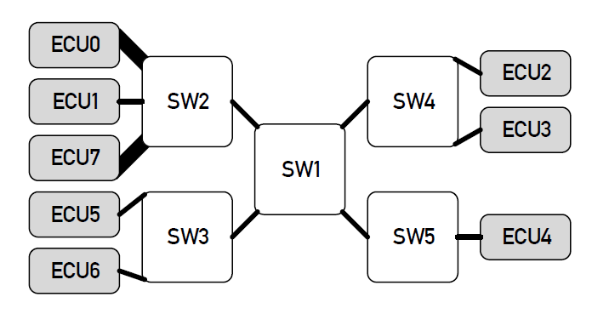
Evaluation
Quadruple Star
Double Star
100 Mbit/s
1 Gbit/s
Tree

Slide 13
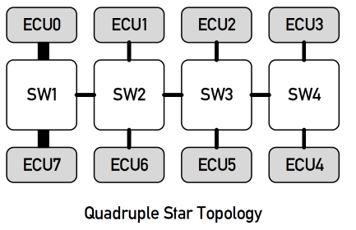
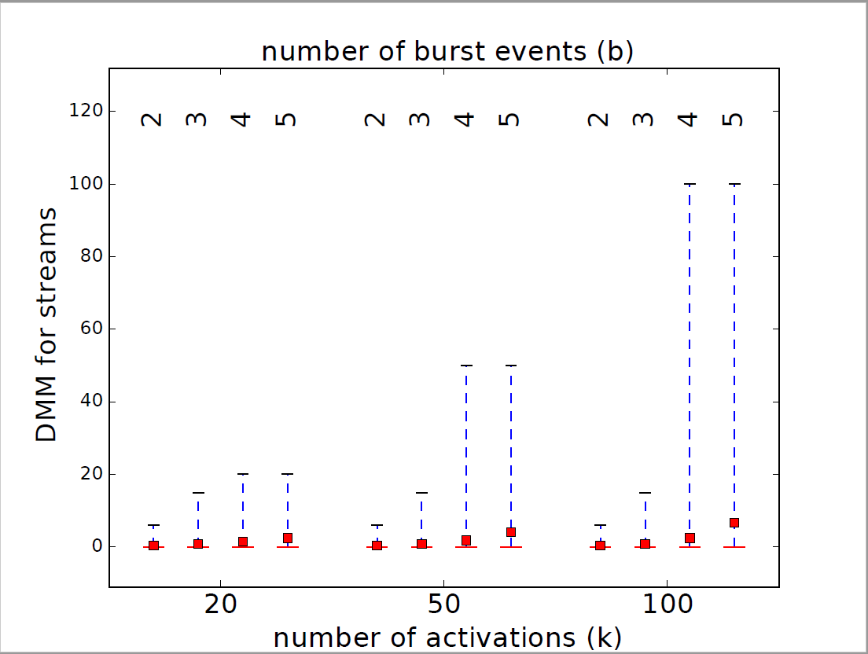
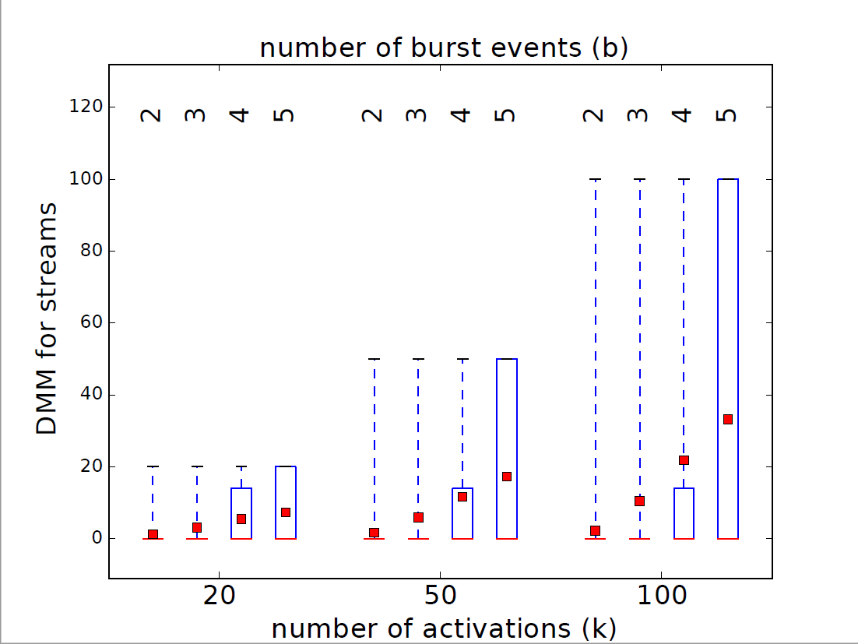



Evaluation
100 Mbit/s
1 Gbit/s
WHRT guarantees for camera streams
→ 50 generated systems with quadruple star topology
+ 5 sporadically bursty control streams
+ 10 sporadically bursty control streams
m
m
m
$$q_{0.75}$$
average
median = $q_{0.5}$
$$q_{0.25}$$
Notes:
what is the actual problem / corner cases / priorities , SPNP
improvement compared to worst case (how many of the lossy cases can be handled?)

Slide 14
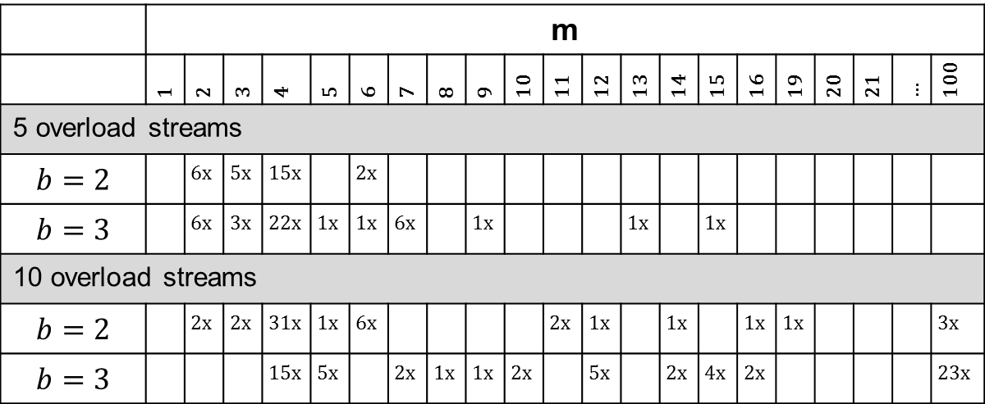
Evaluation
Details on non-zero WHRT results for camera streams with k = 100 (set of 50 systems)
 | m
 | 1 | 2 | 3 | 4 | 5 | 6 | 7 | 8 | 9 | 10 | 11 | 12 | 13 | 14 | 15 | 16 | 19 | 20 | 21 | … | 100
5 overload streams
$$b=2$$ |  | 6x | 5x | 15x |  | 2x
$$b=3$$ |  | 6x | 3x | 22x | 1x | 1x | 6x |  | 1x |  |  |  | 1x |  | 1x
10 overload streams
$$b=2$$ |  | 2x | 2x | 31x | 1x | 6x |  |  |  |  | 2x | 1x |  | 1x |  | 1x | 1x |  |  |  | 3x
$$b=3$$ |  |  |  | 15x | 5x |  | 2x | 1x | 1x | 2x |  | 5x |  | 2x | 4x | 2x |  |  |  |  | 23x
how often m=2 was observed for a camera stream
With hard RT systems, designs must be rejected even if only very few deadline misses occur in k=100 jobs of camera streams.
With weakly-hard RT systems, these designs are valid depending on (m,k)-requirements!
Notes:
occasionally „bad“ results; most cases have a small miss rate

Slide 15
Conclusion
First compositional analysis framework, which provides (m,k)-guarantees for multi-component real-time systems
        CPA (Compositional Performance Analysis) + TWCA (Typical Worst Case Analysis)
        Extended event propagation
        Generalized TWCA (done for SPNP)
Application to real-time networks
        automotive case study
Future work
        extension to cover also SPP scheduling
        increased accuracy

Slide 16
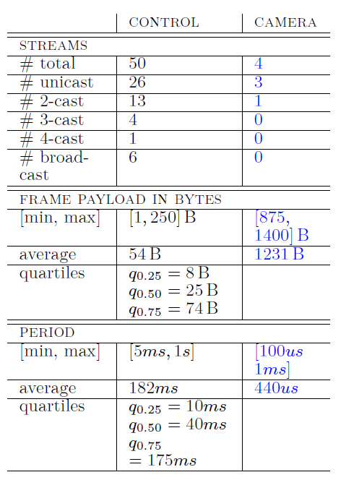
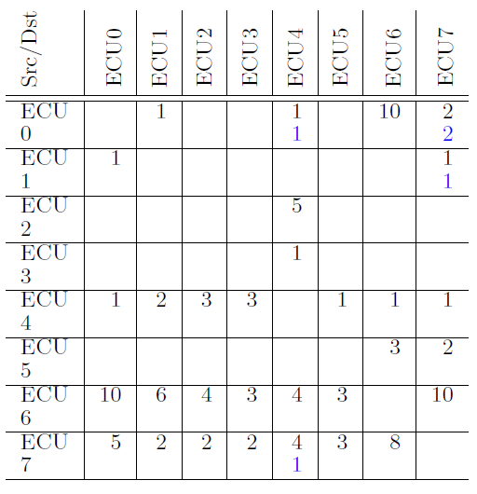
Evaluation
[Thiele et al. 2014]

