Slide 1
Worst-case Stall Analysis for Multicore Architectures with Two Memory Controllers
Muhammad Ali Awan, Pedro F. Souto, Konstantinos Bletsas, Benny Akesson, and Eduardo Tovar

Slide 2
Outline
Motivation
Overview
System Model
Analysis
Heuristics
Evaluation
Conclusions and future direction

Slide 3

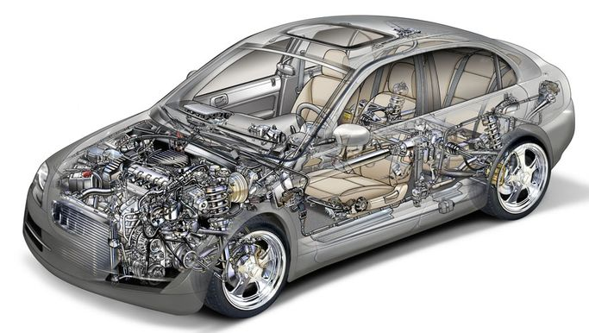
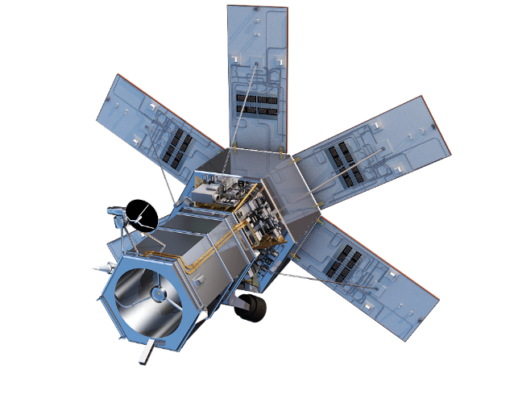

Motivation
Interference
Resource Utilization
Timing Analysis
App 1
App 2
App 3
App 4
Multi-core Platform
Computation
Energy
Weight
Cost
Scalability

Slide 4
Overview
Memory controller
  Single memory controller (Memguard)
Things to improve on
  Platforms with two memory controllers (e.g., NXP QorIQ series)
Potential benefits
  Handles task dependencies
  Flexibility in memory bandwidth allocation

Slide 5

Platform
Two shared memory controllers
Non-overlapping memory regions
Homogeneous multi-core platform
Round robin arbitration
Last-level cache is partitioned or private
Multiple outstanding memory requests
Prefetchers and speculative units are disabled
Constant memory accesses time
Performance monitoring counters per core for each controller

Slide 6
Task Model
WCET
Sporadic tasks
Constrained deadline
CPU Computation (Ce)
Memory accesses (C^{m})
No migration
Controller one (C^{m1})
Controller two (C^{m2})
Fixed priority Scheduling
CPU Computation and memory accesses do not overlap in time

Slide 7
Memory Access Regulation Model
Memory accesses are regulated on both controllers (with aligned regulation periods)
a
Core a memory access
Memory budget (Q) exhausted
b
Core b memory access
c
Core c memory access
Contention stall
d
Core d memory access
Controller one
a
a
a
a
b
c
d
a
Regulation period (P)
Regulation stall
Each core has a per-controller budget
Uneven memory bandwidth (b = Q/P) across cores and controllers
Budget exhausted
Contention stall
Controller two
a
a
c
d
b
a
Regulation period
Regulation stall

Slide 8
Main Idea
Core 1
Core 2
Core 3
Core 4
Core 1
Core 2
Core 3
Core 4
Controller 1
Controller 2
Controller 1
Controller 2
Partitioned Case
Shared Case

Slide 9
Main Contributions
Show that existing techniques are not safe
Worst-case memory stall analysis for architectures with two memory controllers shared by all cores
Five stall-cognisant heuristics for i) memory-bandwidth-to-core assignment, and ii) task-to-core assignment

Slide 10
Yao’s Analysis (1)
Regulation domination case: (b ≤ 1/m)
Memory accesses from core i
Example
Q = 2
P = 24
m = 4
C^{m} = 5
Ce = 7
Memory accesses from other cores
CPU computation
Maximize the regulation stall
Contention stall
Initial regulation stall
Regulation stall
Regulation stall
0
24
48
72
96

Slide 11
Yao’s Analysis (2)
Contention domination case: (b > 1/m)
Example
Q = 12
P = 24
m = 4
C^{m} = 10
Memory accesses from core i
Memory accesses from other cores
CPU computation
Initial regulation stall
0
24
48
72
96
a) Enough CPU computation
Initial regulation stall
0
24
48
72
96
b) Not enough CPU computation

Slide 12
Why Yao’s Analysis Fails with 2 Controllers
C^{m1} = C^{m2} = 12 Q1 = Q2 = 6 m = 4 P = 12
Stall = 24
0
12
24
36
48
Stall = 72
0
12
24
36
48
84
96
Contention stall
Access via controller 1
Access via controller 2

Slide 13
New Stall Analysis
Case 1 (Regulation dominant): $b1≤ \frac{1}{m}∧ b2≤ \frac{1}{m}$
Case 2 (Contention dominant): $b1> \frac{1}{m}∧ b2> \frac{1}{m}$
Case 3 (both): $\left(b1≤ \frac{1}{m}∧ b2> \frac{1}{m}\right)∨\left(b1> \frac{1}{m}∧ b2≤ \frac{1}{m}\right)$

Slide 14

Case 1 (Regulation dominant): $b1≤ \frac{1}{m} ∧ b2≤ \frac{1}{m}$
Example
Q1 = 2
Q2 = 3
P = 24
m = 4
C^{m1} = 5
C^{m2} = 4
Ce = 7
Access via controller 1
Access via controller 2
Maximize the regulation stall for both controllers
CPU computation
Contention stall
Contention stall
Regulation stall
Regulation stall
Regulation stall
0
24
48
72
96

Slide 15

Case 2 (Contention dominant): $b1> \frac{1}{m} ∧ b2> \frac{1}{m}$
0
24
48
72
96
Phase 1
Phase 2
Phase 3
Example
Q1 = 18
Q2 = 18
P = 24
m = 4
C^{m1} = 12
C^{m2} = 5
Ce = 36
2a)
Access via controller 1
Access via controller 2
CPU computation
Contention stall

Slide 16
Case 2 (Contention dominant): $b1> \frac{1}{m} ∧ b2> \frac{1}{m}$
Example
Q1 = 18
Q2 = 9
P = 24
m = 4
2b)
C^{m1} = 6
C^{m2} = 10
Ce = 0
Finish at the same time
Stall = 48
0
24
48
72
96
Stall = 42
0
24
48
72
96
Access via controller 1
Access via controller 2
CPU computation
Contention stall

Slide 17

Case 3 (both): $\left(b1≤ \frac{1}{m}∧ b2> \frac{1}{m}\right)∨\left(b1> \frac{1}{m}∧ b2≤ \frac{1}{m}\right)$
Example
Q1 = 2
Q2 = 6
P = 12
m = 4
C^{m1} = 4
C^{m2} = 6
Ce = 0
Regulation stall
Regulation stall
Stall = 26
0
12
24
36
48
Stall = 30
0
12
24
36
48
Access via controller 1
Access via controller 2
CPU computation
Contention stall

Slide 18
Schedulability Analysis
Schedulability analysis
Single task stall analysis
Jobs of higher or equal priority tasks that can preempt a task under analysis
Task under analysis
Ce
C^{m1},C^{m2}
Q1, Q2
Composite Task
Stall Analysis
Ce
C^{m1 ,} C^{m2}
Upper bound on Stall
Standard response time analysis demand
WCRT = Stall + Total demand (Ce + C^{m1} +C^{m2})

Slide 19
Bandwidth Allocation and Task-to-core Assignment Heuristics
Even
- Each Core has an equal memory bandwidth share of both controllers
- First-fit bin packing for task-to-core assignment
Five Heuristics
Uneven
- Initially each core gets an equal memory bandwidth share for each controller - Trim-off memory bandwidth from both controllers, if tasks are not schedulable with equal memory bandwidth
- Use this trimmed bandwidth to schedule remaining tasks
Priority assignment: Audsley’s algorithm
(not necessarily optimal)
Greedy-fit
- Assign all memory bandwidth from both controllers to first core
- Iterate over all tasks to assign as many as possible
- Trim the memory bandwidth for each controller on this core to assign to the next core and assign remaining tasks to this core
Humble-fit
- Similar to greedy fit, except move to next core upon first failure
Memory-fit
- Assign a task to the core that requires the least additional memory bandwidth

Slide 20

Evaluation
Synthetic workload generated with the UUnifast-discard algorithm
Inter-arrival times with log-uniform distribution (10-100 ms)
Implicit deadlines
Memory accesses for each controller are generated randomly
1000 task-sets for each set of input parameters
Task-set is sorted in descending order of utilization
Compare weighted schedulability

Slide 21
Results
Partitioned memory controllers among cores
  Half of the cores assigned to each controller
  Each heuristic adapted for this arrangement
  “Yao-” prefix followed by the heuristic’s name
Shared memory controllers
  “MC-” prefix followed by each heuristic

Slide 22
Results

Slide 23
Conclusions and Future Directions
Existing stall analysis for single-memory controller systems is not applicable to dual-controller systems
We developed safe analysis for the latter case
Partitioning of the controllers performs better than sharing in our experiments:
  but it may not always be practical
    resource sharing across controller domains
    Tasks with very unbalanced bandwidth requirements.
  We quantify the performance tradeoff
In the future, we are considering extending this to a mixed-criticality context (Vestal model)

Slide 24
Questions ?

